Slide 1
Advanced and Bucket Sorting and Search Algorithms

Slide 2
Algorithm Classification
Sorting algorithms are classified based on the amount of effort (number of comparisons and swaps) it takes to sort a list of data items.
Simple Sorting:
O(n^2)
Bubble (Exchange) sort, Insertion sort, Selection sort, others…
Advanced Sorting:
O(nLogn)
Merge sort, Quick sort, Tree sort, Heap sort, , others…
Bucket Sorting:
O(k*n)
Radix sort of integer data (k is # of digits in the largest number in the data set).

Slide 3
Merge Sort
Merge sort is the process of divide and conquer. That is, the list is divided into 2 sublists and each sublist is further divided into 2 sublist, and so on until the sublist size is one element. Next, the conquer step is applied to re-build the list by merging the sublist to be in order.
Merge sort is a recursive process such that the output of the merge step is an ordered sublist.
This merge step is the core of the algorithm.
mergeSort(list){
If (list length > 1)
{ firstHalf = mergeSort(firstHalf); //recursive call secondHalf = mergeSort(secondHalf); //recursive call list = merge(firstHalf, secondHalf);//conquer step
}
}

Slide 4
Merge Sort
 | 2 | 9 | 5 | 4 | 8 | 1 | 6 | 7
split
2 | 9 | 5 | 4
8 | 1 | 6 | 7
split
divide
2 | 9
5 | 4
8
1
6 | 7
split
2
9
5
4
8
1
6
7
merge
2
9
4 5
1
8
6
7
conquer
merge
merge
2 | 4 | 5 | 9 |  | 1 | 6 | 7 | 8
1 | 2 | 4 | 5 | 6 | 7 | 8 | 9

Slide 5
Merge Two Sorted Lists
current1
current2
current1
current2
current1
current2
2 | 4 | 5 | 9
1 | 6 | 7 | 8
2 | 4 | 5 | 9
1
6
7
8
2 | 4 | 5 | 9
1 | 6 | 7 | 8
1
1
2
4
5
6
7
8
1 | 2 | 4 | 5 | 6 | 7 | 8 | 9
current3
(b) After moving all the elements in list2 to temp
current3
(c) After moving 9 to temp
current3
(a) After moving 1 to temp

Slide 6
Merge Sort Time
Let T(n) denote the time required to sort an array of n elements using merge sort.
Without loss of generality, assume n is a power of 2. The merge sort algorithm splits the array into two subarrays, sorts the subarrays using the same algorithm recursively, and then merges the subarrays. So,
T (n) = T ( ^{n} ) + T ( ^{n} ) + mergetime
2 2

Slide 7
Merge Sort Time
The first T(n/2) is the time for sorting the first half of the array and the second T(n/2) is the time for sorting the second half.
To merge two subarrays, it takes at most n-1 comparisons to compare the elements from the two subarrays and n moves to move elements to the temporary array. So, the total time is 2n-1.
Therefore,
T (n) = 2T ( ^{n} ) + 2n − 1 = 2(2T ( ^{n} ) + 2 ^{n} − 1) + 2n − 1 = 2² T ( ^{n} ) + 2n − 2 + 2n − 1
2 4 2
₂2
= 2^{k} T ( ^{n} ) + 2n − 2^{k −1} + ... + 2n − 2 + 2n − 1
₂k
₌ ₂log n _{T (}
n
₂log n
) + 2n − 2^{log n−1} + ... + 2n − 2 + 2n − 1
= n + 2n logn − 2^{log n} + 1 = 2n logn + 1 = O(n logn)

Slide 8
Quick Sort
Quick sort is a recursive process such that the output of a step is re- arrangement of elements so that one element is in its sorted position and the two sublists remain unsorted.
If the list of element is x₁, x₂, x₃, …, x_{n}, then one step of quick sort re- arranges elements as follows:
x₁, x₂, x₃, ... x_{j-1}, x_{j} , x_{j+1}, x_{j+2}, ..., x_{n}
smaller than x_{j} sorted greater than x_{j}
This is called partition step, which is the core step of the algorithm.

Slide 9
Quick Sort
Partition Step Algorithm: (ascending order)
Swap x(1) and x(n) if necessary
Set left = x(1) // this is called pivot or split element
Set low x(2) and high to x(n) // these are pointer
Scan list from left to right for x(j) >= left value. //low pointer
Scan list from right to left for x(k) <= left value. //high pointer
If (j < k) Then Swap (x(j), x(k)) and continue scanning
If (j >= k) // pointer crossed each other
Then If left >= x(k), Swap and left is the split element.
Else no Swap (left, x(k)) and x(k) is the split element.
Exit.
Repeat step 1 through step 6 until list is sorted.

Slide 10
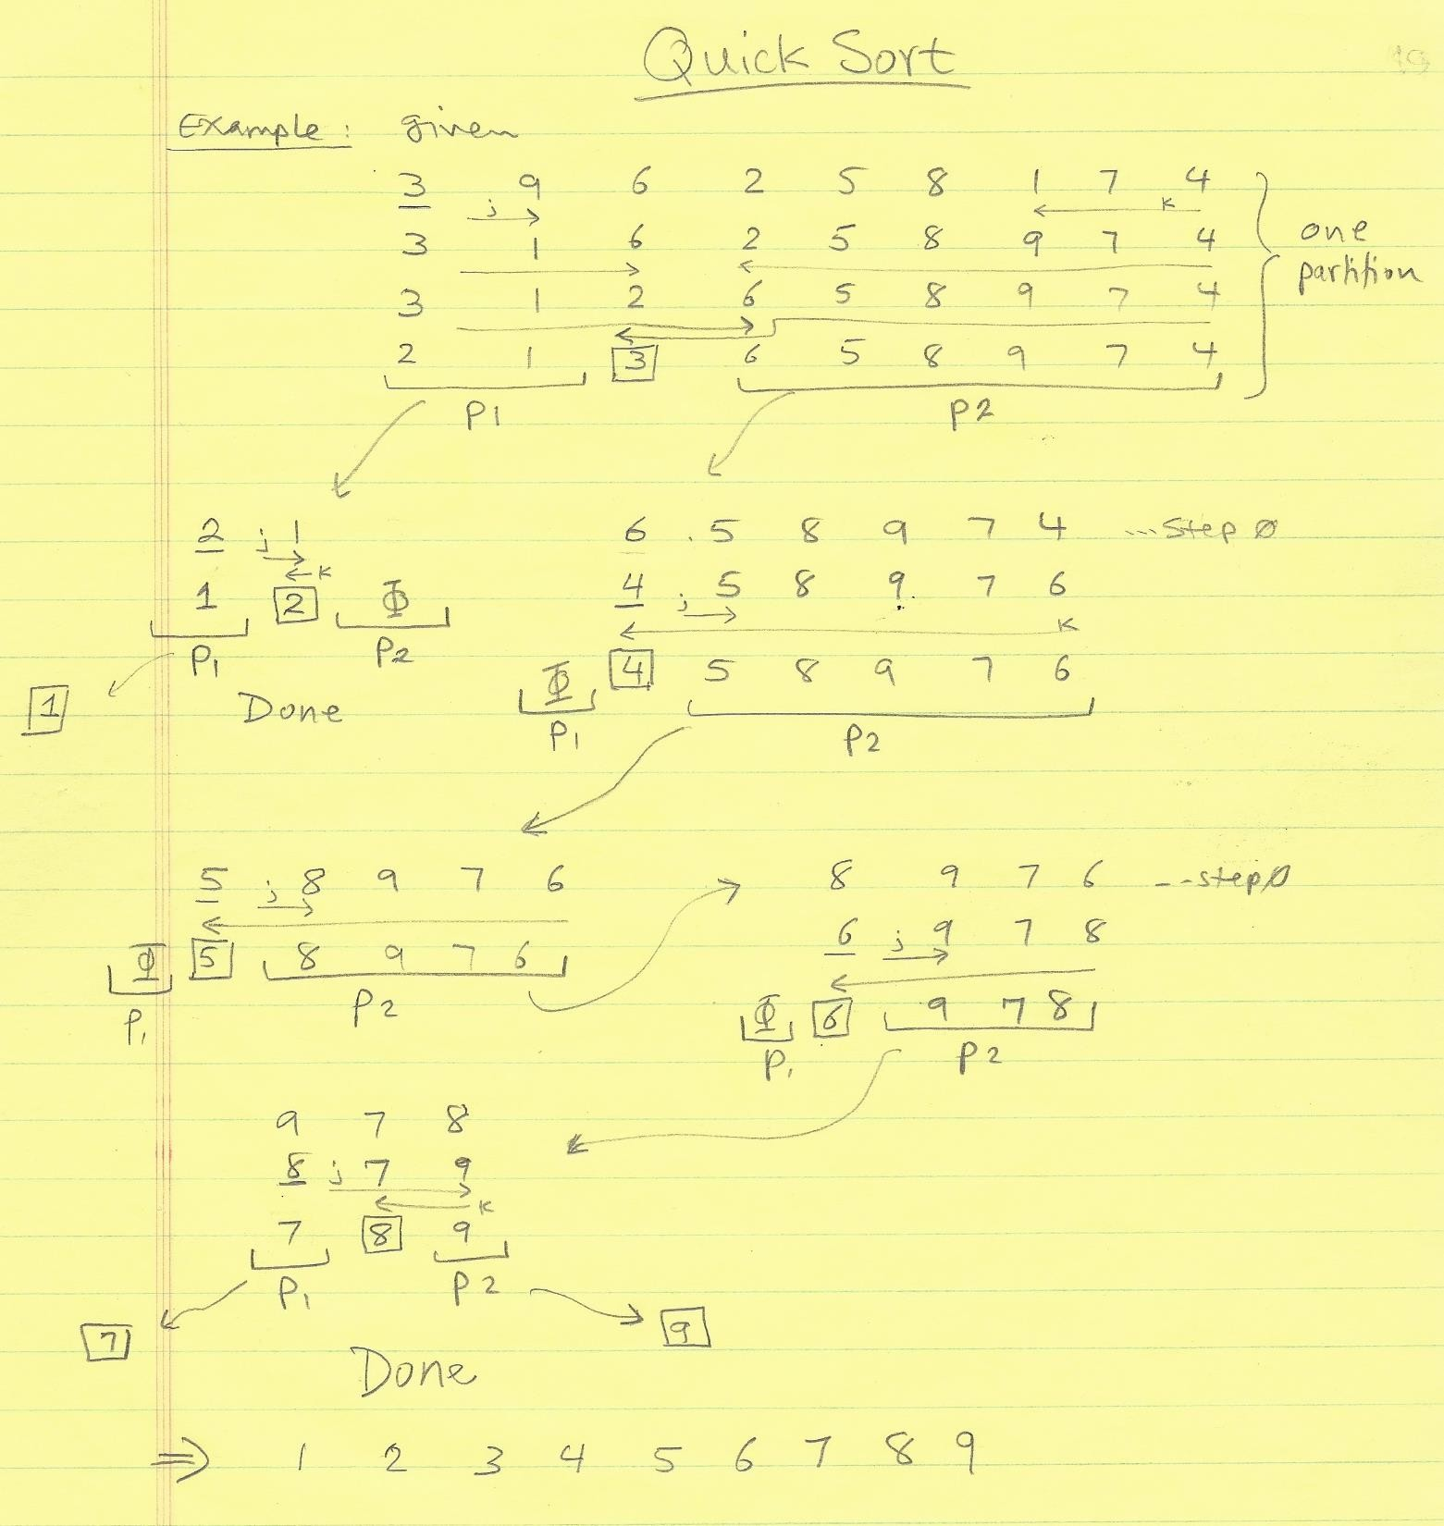
Quick Sort Example

Slide 11
pivot
low
high
Partition Step Illustration
5 | 2 | 9 | 3 | 8 | 4 | 0 | 1 | 6 | 7
(a) Initialize pivot, low, and high
pivot
low
high
5 | 2 | 9 | 3 | 8 | 4 | 0 | 1 | 6 | 7
(b) Search forward and backward
pivot
low
high
5 | 2 | 1 | 3 | 8 | 4 | 0 | 9 | 6 | 7
(c) 9 is swapped with 1
pivot
low
high
5 | 2 | 1 | 3 | 8 | 4 | 0 | 9 | 6 | 7
(d) Continue search
pivot
low
high
5 | 2 | 1 | 3 | 0 | 4 | 8 | 9 | 6 | 7
(e) 8 is swapped with 0
pivot
low
high
5 | 2 | 1 | 3 | 0 | 4 | 8 | 9 | 6 | 7
(f) when high < low, search is over
pivot
4 | 2 | 1 | 3 | 0 | 5 | 8 | 9 | 6 | 7
(g) pivot is in the right place
The index of the pivot is returned
11

Slide 12






Quick Sort Time
In the worst case, each time the pivot divides the array into one big subarray with the other one empty subarray. The size of the big subarray is one less than the one before being divided. So, the maximum time is
T (n) = (n −1) +(n − 2) + ... + 2 +1 = O(n² )
In the best case, each time the pivot divides the array into two parts of about the same size. Let T(n) denote the time required to sort an array of elements using quick sort. So, the minimum time is
T (n) = T ( ^{n} ) + T ( ^{n} ) +n = O(n logn) 2 2
On the average, the pivot neither divides the array into two parts of the same size nor one empty part. Statistically, the sizes of the two parts are very close. So the average time is O(nlogn). See Merge Sort analysis.

Slide 13
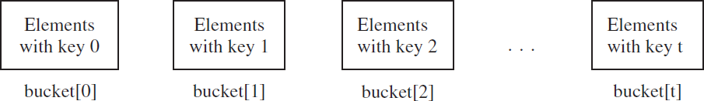

Bucket (Radix) Sort
Simple and advanced sorting algorithms work for any types of keys (e.g., integers, strings, and any comparable objects). These algorithms sort the elements by comparing their keys. The lower bound for these algorithms is O(nlogn). So, no sorting algorithms based on comparisons can perform better than O(nlogn). However, if the keys are small integers, we can use bucket sort without having to compare the keys.
Bucket (Radix) sorting works as follows. Assume the keys are in the range from 0 to N-1. We need N buckets labeled 0, 1, ..., and N-1. If an element’s key is i, the element is put into the bucket i. Each bucket holds the elements with the same key value.

Slide 14


Radix Sort Using Stacks
Radix sort is very efficient if memory is not an issue. It requires extra space proportional to the size of the data set (array).
Radix sort complexity is O(k*n) where k is the maximum number of digits in the largest data element; and n is the size of the data set. That is, O(n) linear growth.
Radix sort implemented using stacks (buckets), you need 10 stacks, one for each digit (S0 to S9).
Algorithm:
scan input data list from right to left.
drop (push) elements onto stacks that correspond to the digit being considered during the current phase of the sorting process.
empty (pop) the stacks (from S0 to S9) back to the list.
repeat the process for k times.
This requires a method to extract digits from numbers.

Slide 15
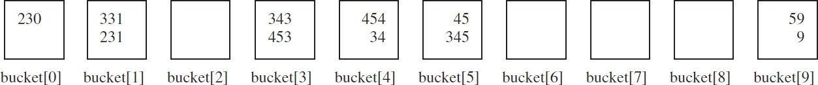
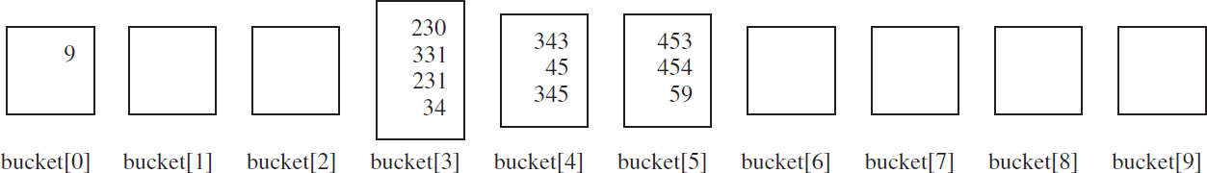
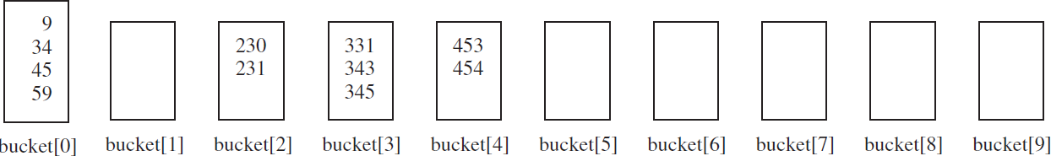




Example: Radix Sort (using stacks)
Phase 1 (1st digit): 331, 454, 230, 34, 343, 45, 59, 453, 345, 231, 9
Phase 2 (2nd digit): 230, 331, 231, 343, 453, 454, 34, 45, 345, 59, 9
Phase 3 (3rd digit): 9, 230, 331, 231, 34, 343, 45, 345, 453, 454, 59
Sorted List: 9, 34, 45, 59, 230, 231, 331, 343, 345, 453, 454

Slide 16

Radix Sort Using Queues
Radix sort can also be implemented using queues. We need 10 queues, one for each digit (Q0 to Q9).
Algorithm:
scan input data list from left to right.
drop (enqueue) elements into queues that correspond to the digit being considered during the current phase of the sorting process.
empty (dequeue) the queues (from Q0 to Q9) back to the list.
repeat for k times.
This requires a method to extract digits from numbers.

Slide 17
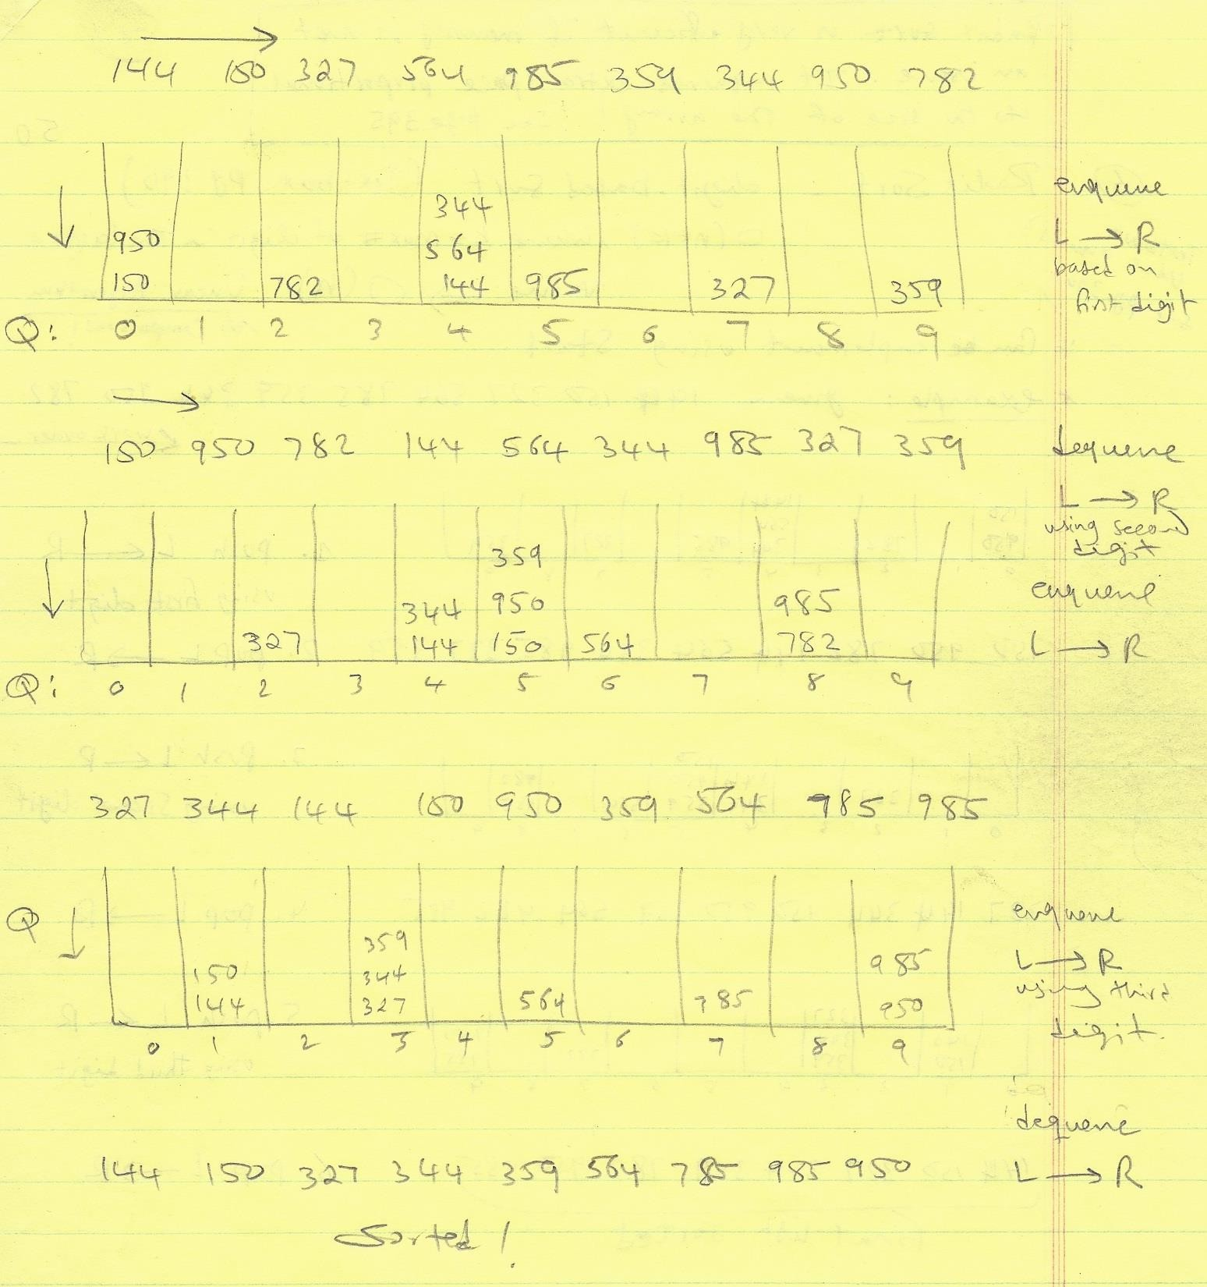
Radix Sort (using queue)

Slide 18
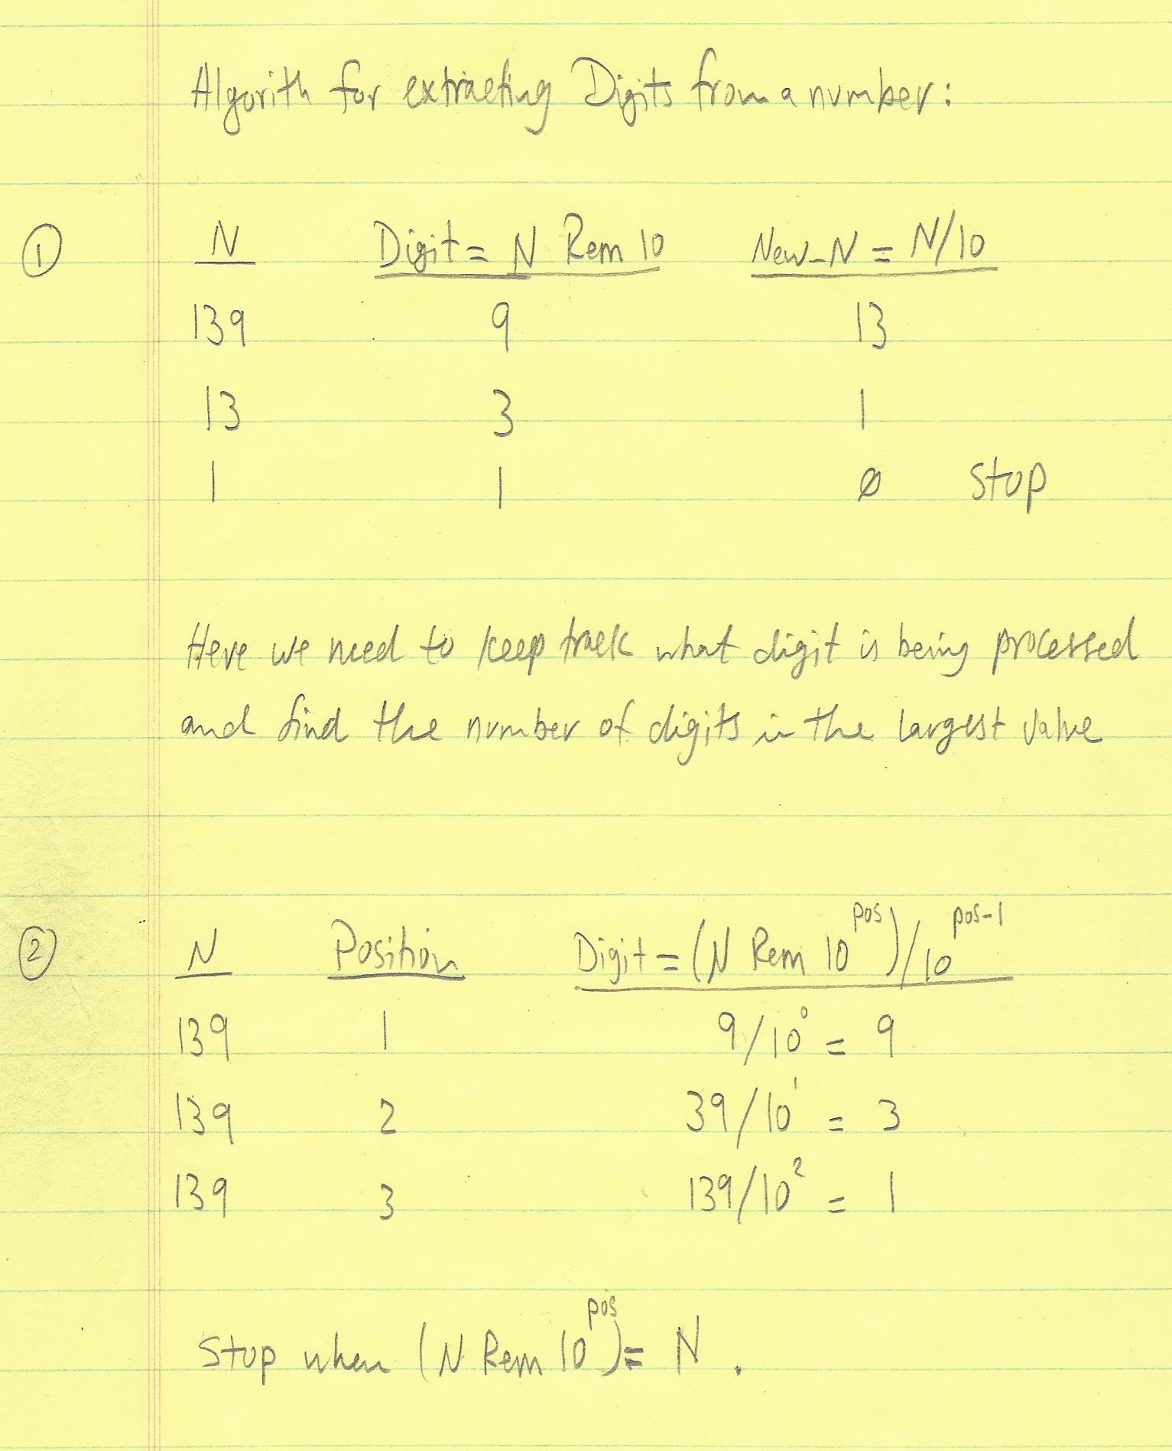
Digit Extraction

Slide 19
External Sort Concept
All sort algorithms we discussed perform internal sorting. That is, all data elements in a list to be sorted can be loaded to the internal memory at once. The sorting process is carried out in the memory.
To sort data stored in an external file that is too large to load to the internal memory, we load the data to the memory in parts (segments) and apply internals sorting.
Program
Original file
Array
Temporary file
 |  | ……
S₁
S₂
S_{k}

Slide 20
Two-Phase Process
Phase I: Repeatedly bring data from the file to an array, sort the array using an internal sorting algorithm, and output the data from the array to a temporary file
Program
Original
Array
Temporary
S₁ S₂
 |  | ……

Slide 21
Two-Phase Process
Phase II: Merge a pair of sorted segments (e.g., S1 with S2, S3 with S4, ..., and so on) into a larger sorted segment and save the new segment into a new temporary file. Continue the same process until one sorted segment results for this process.
S₁ |  | S₂ |  | S₃ |  | S₄ |  | S₅ |  | S₆ |  | S₇ |  | S₈
Merge
Merge
S₁, S₂ merged |  | S₃, S₄ merged |  | S₅, S₆ merged |  | S₇, S₈ merged
S₁, S₂, S₃, S₄ merged
S₅, S₆ , S₇, S₈ merged
Merge
S₁, S₂, S₃, S₄ , S₅, S₆ , S₇, S₈ merged

Slide 22
Search Algorithms
Searching is the process of looking for a specific element in a a data set. The element may be found or may not.
How to search? Two commonly used methods are:
Linear search: search all elements in sequence from first to last.
Binary search: search an ordered list taking into consideration one-half of the list in each stop.

Slide 23
Linear Search
The linear search approach compares the key element (target) sequentially to each element in the list. The method continues to do so until the key matches an element in the list or the list is exhausted without a match being found. If a match is found, the linear search returns the index of that element in the list. If no match is found, the search fails (returns -1). The search time is O(n).
public class LinearSearch {
/** The method for finding a key in the list */ public static int linearSearch(int[] list, int key) {
for (int i = 0; i < list.length; i++)
if (key == list[i]) return i;
return -1;
[0] [1] [2] …
list
}
key Compare key with list[i] for i = 0, 1, …
}

Slide 24
Binary Search
For binary search to work, the list must be sorted first.
Algorithm: Given ordered list and a key, binary search first compares the key with the element in the middle of the list.
If the key is less than the middle element, recursively call binary search on the first half of the list.
If the key is equal to the middle element, the search ends and returns the index of that element.
If the key is greater than the middle element, recursively call binary search on the first half of the list.
The search time is O(log n).

Slide 25
Example
key is 11
low
mid
high
key < 50
[0] [1] [2] [3] [4] [5] [6] [7] [8] [9] [10] [11] [12]
list
2 4 7 10 11 45 50 59 60 66 69 70 79
low
mid high
[0] [1] [2] [3] [4] [5]
key > 7
list
2 4 7 10 11 45
low
mid high
[3] [4] [5]
key == 11
list
10 11 45

Slide 26
Example
key is 54
low
mid
high
key > 50
[0] [1] [2] [3] [4] [5] [6] [7] [8] [9] [10] [11] [12]
list
2 4 7 10 11 45 50 59 60 66 69 70 79
low
mid high
[0] [1] [2] [3] [4] [5] [6] [7] [8] [9] [10] [11] [12]
key < 66
list
59 60 66 69 70 79
low mid
high
[7] [8]
key < 59
list
59 60
low high
[6] [7] [8]
59 60

Slide 27
Implementation
/** Use binary search to find the key in the list */ public static int binarySearch(int[] list, int key) {
int low = 0;
int high = list.length - 1;
while (high >= low) {
int mid = (low + high)/2; //middle element
if (key < list[mid]) high = mid - 1;
else if (key == list[mid])
return mid; //target is found, return its index
else
low = mid + 1;
}
return -1-low; //target not found, return negative value
}

Slide 28
Time Complexity Analysis
The analysis for best, worst, and average case (for number of comparisons) is dependent upon the size of the list, say n.
Best case scenario: One comparison. O(1)
Worst case scenario: The key may not exist in the list. Through each recursive call, the size of the admissible range is halved. This halving process can be done in log n comparisons. O(log n)
Average case scenario: O(log n) comparisons.
Note: The difference between O(log n) and O(n) (linear search) is extremely significant when n is large. For practical problem we should avoid linear search. For example, for a list of size 2 billion elements, linear search would involve about a billion comparisons; while binary search would require only 32 comparisons!

Slide 29
End of Slides

